Slide 1
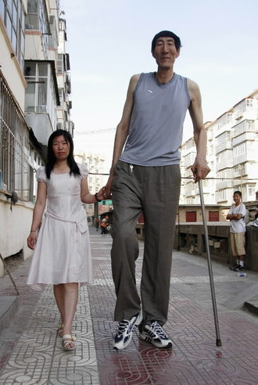
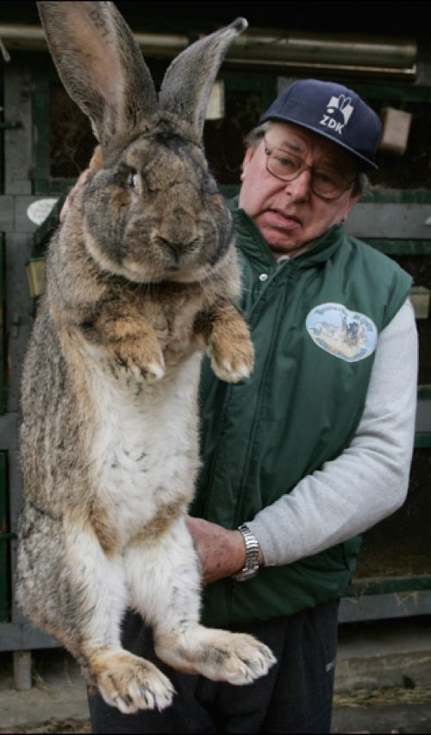
Anomalous
(adj) abnormal, irregular, departing from the usual
Synonyms: exceptional, atypical, unusual, aberrant

Slide 2
Aspersion
Think twice before casting aspersions on his honesty, for he might be telling the truth.
(noun) a damaging or derogatory statement; the act of slandering or defaming
Synonyms: innuendo, calumny, denigration

Slide 3
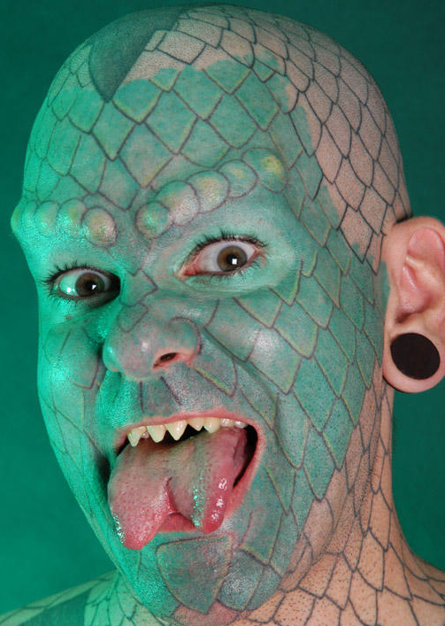
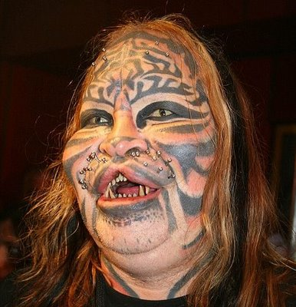
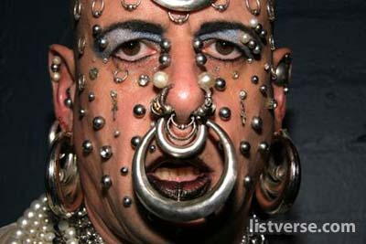
Bizarre
(adj) extremely strange, unusual, atypical
Synonyms: grotesque, fantastic, outlandish

Slide 4
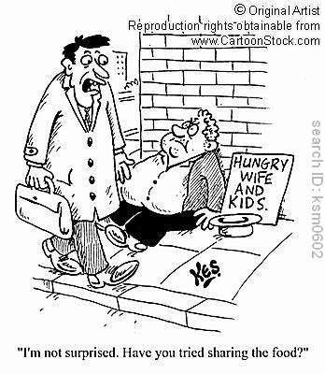
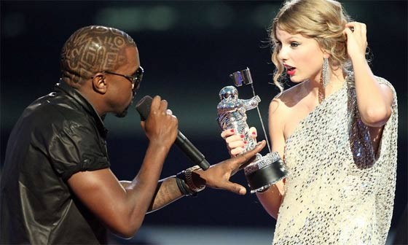
Brusque
(adj) abrupt, blunt, with no formalities
Synonyms: curt, tactless, ungracious, gruff, rough

Slide 5
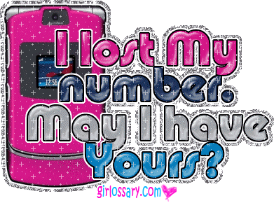
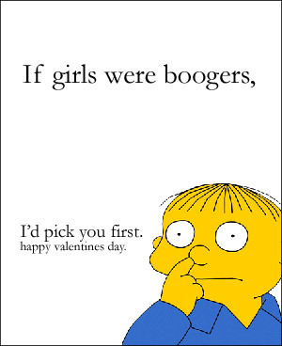
Cajole
(v.) to coax, persuade through flattery or artifice; to deceive with soothing thoughts or false promises
Synonyms: wheedle, inveigle, soft-soap, sweet-talk

Slide 6
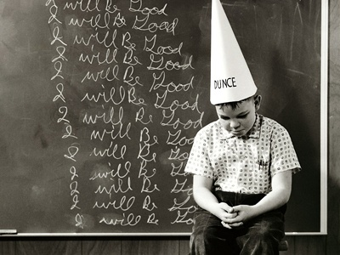
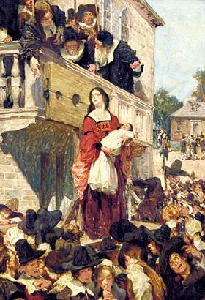
Castigate
After he castigated the unruly children, they settled down to study quietly.
(v.) to punish severely; to criticize severely
Synonyms: chastise, rebuke, censure, upbraid

Slide 7
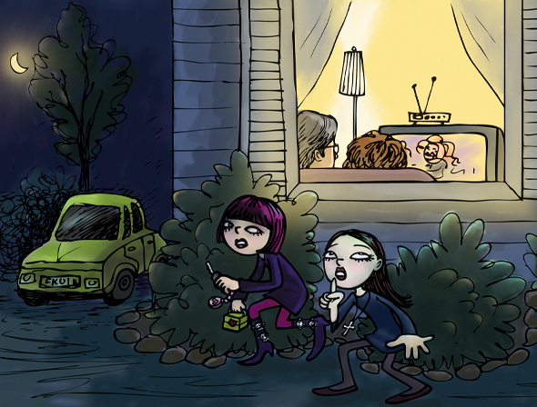
Contrive
She can contrive wonderful excuses; but when she tries to offer them, her uneasiness gives her away.
(v.) to plan with ingenuity, invent; to bring about as the result of a scheme or plan
Synonyms: think up, devise, concoct, fabricate

Slide 8
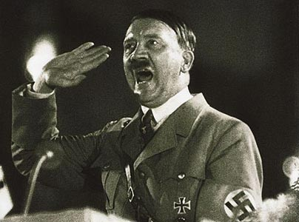
Demagogue
Often a show of angry concern conceals the self-serving tactics of a demagogue.
(n.) a leader who exploits popular prejudices and false claims and promises in order to gain power
Synonyms: rabble-rouser, firebrand

Slide 9
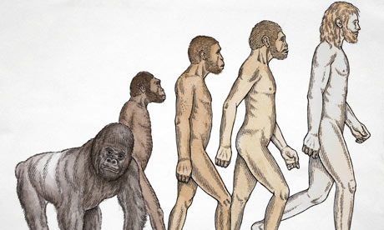
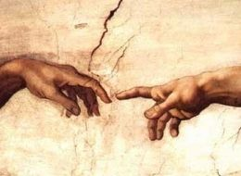
Disabuse
(v.) to free from deception or error, set right in ideas or thinking
Synonyms: undeceive, enlighten, set straight

Slide 10
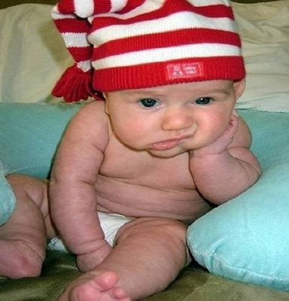
Ennui
Some people seem to confuse sophistication with ennui.
(n.) weariness and dissatisfaction from lack of occupation or interest, boredom
Synonyms: languor, world-weariness, listlessness

Slide 11
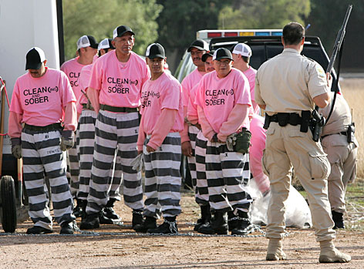
Fetter
The old phrase “chain gang” refers to prisoners made to work, each joined to the next by linked fetters.
(n.) a chain or shackle placed on the feet (often used in plural); anything that confines or restrains; (v.) to chain or shackle, to render helpless or impotent
Synonyms: bond, restraint, bind, hamper

Slide 12
Heinous
A town so peaceful, quiet, and law-abiding was bound to be horrified by so heinous a crime.
(adj.) very wicked, offensive, hateful
Synonyms: evil, odious, abominable, outrageous

Slide 13
Immutable
Scientists labored to discover a set of immutable laws of the universe.
(adj.) not subject to change, constant
Synonyms: unchangeable, unalterable, fixed, invariable

Slide 14
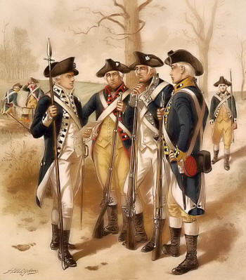
Insurgent
The army was confident that they could crush the insurgent forces.
(n.) one who rebels or rises against authority; (adj.) rising in revolt, refusing to accept authority; surging or rushing in or on
Synonyms: revolutionary, rebellious, mutinous

Slide 15
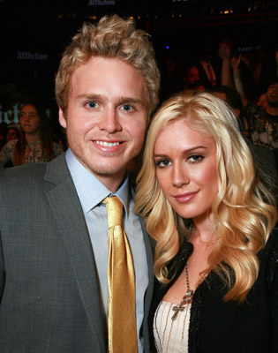
Megalomania
(n.) a delusion marked by a feeling of power, wealth, talent, etc., far in excess of reality.
Synonyms: delusions of grandeur

Slide 16
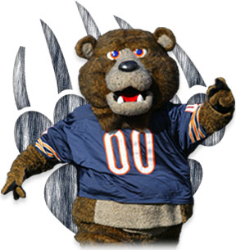
Sinecure
(n.) a position requiring little or no work;
an easy job
Synonyms: “no-show” job, cushy job, “plum”

Slide 17
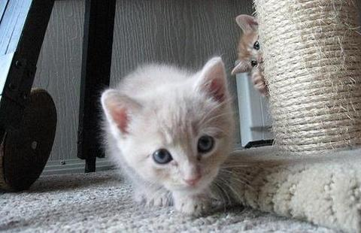
Surreptitious
The movie heroine blushed when she noticed the surreptitious glances of her admirer.
(noun) stealthy, secret, intended to escape observation; made or accomplished by fraud
Synonyms: furtive, covert, clandestine, concealed

Slide 18
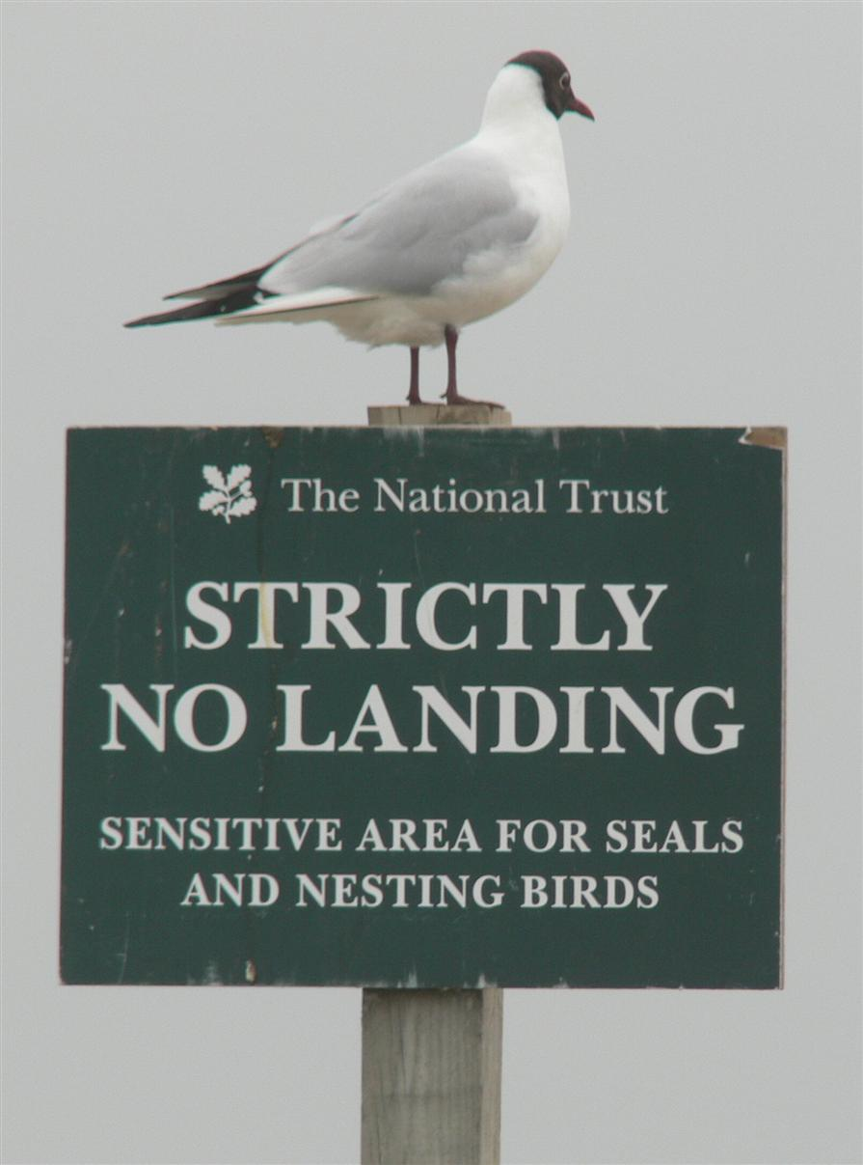
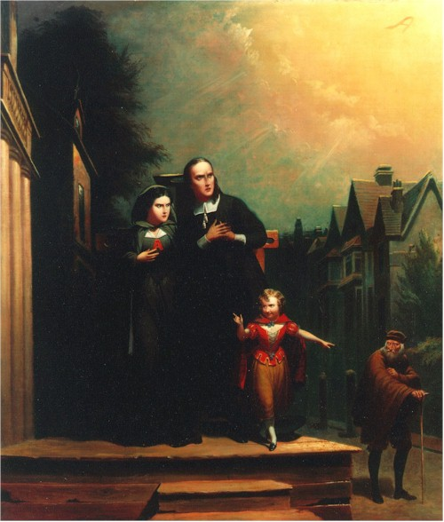
Transgress
The penitent citizens promised to never again transgress the laws of the land.
(v.) to go beyond a limit or boundary; to sin, violate a law
Synonyms: overstep, exceed, trespass, err

Slide 19
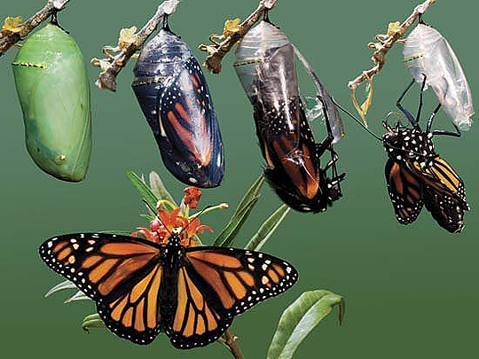
Transmute
(v.) to change from one nature, substance, or form to another
Synonyms: transform, convert, translate, metamorphose

Slide 20
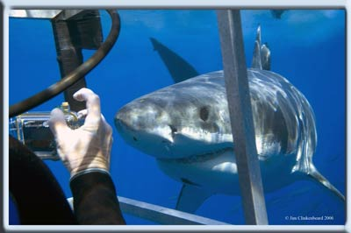
Vicarious
(adj.) performed, suffered, or otherwise experienced by one person in place of another
Synonyms: surrogate, substitute, imagined, secondhand

